Slide 1
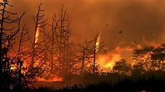
Forest fires
江昱峰

Slide 2
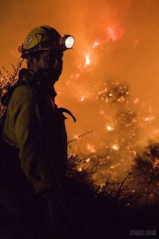
Content
The types of forest fire
The cause of forest fire
The danger and effects of forest fire
Ways to prevent it
When a forest fire happens……

Slide 3
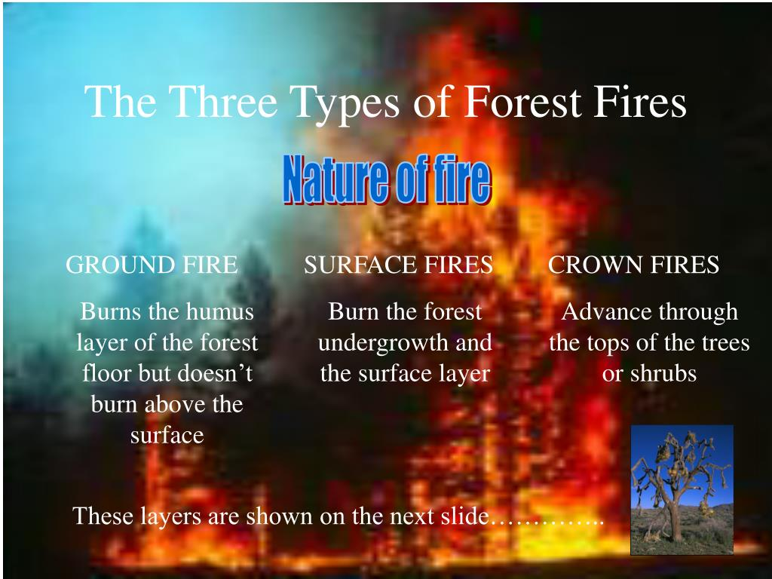

Slide 4
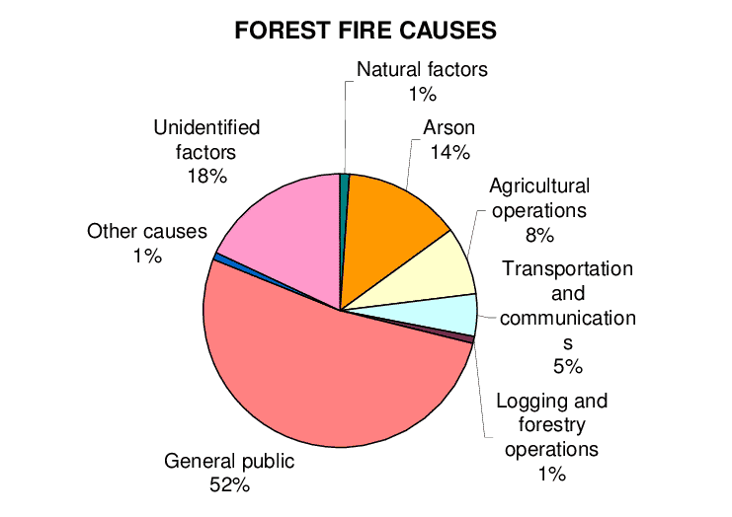
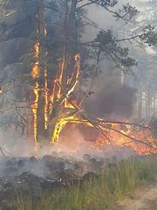
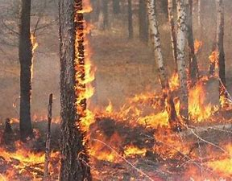
The cause of forest fire

Slide 5
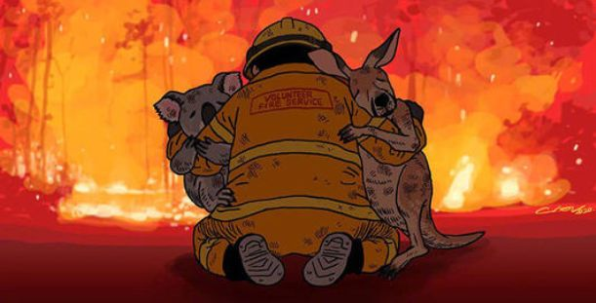
The danger and effects of forest fire
Loss of forest areas and trees
Increased levels of carbon dioxide
Dust & smoke——respiratory disorders
An increased risk of landslides and flooding
Decrease of biological diversity
Chemical-pollution
Degradation & break of natural balance
Humans’ life influenced & economy suffered

Slide 6
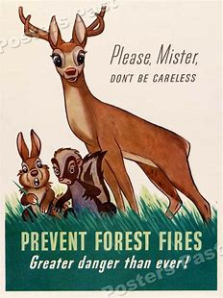
Ways to prevent the forest fire
Avoid smoking
Do not leave any material that can burn
Never throw cigarette butts or matches
Do not light fires in areas close to vegetation

Slide 7
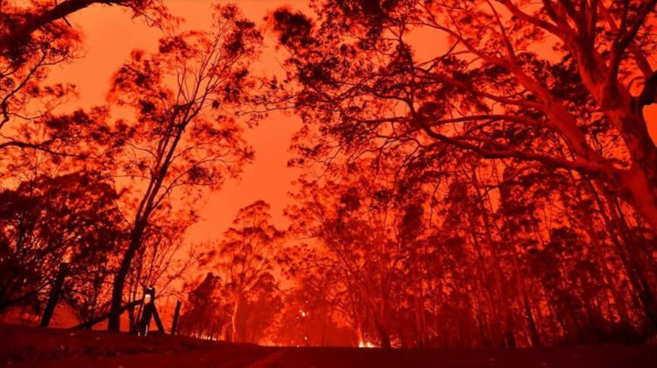
When a forest fire happens……
Cover your mouth and nose with a damp cloth
Pay attention to the behavior of fire and wind
Walk near shallow open waters
Do not return to the burned area

Slide 8
Thanks for listening!

